Slide 1
Final Presentation
ECE 1160/2160
Max Reno, Tyler Garrett, Christen Rittiger, Zach Scheider

Slide 2
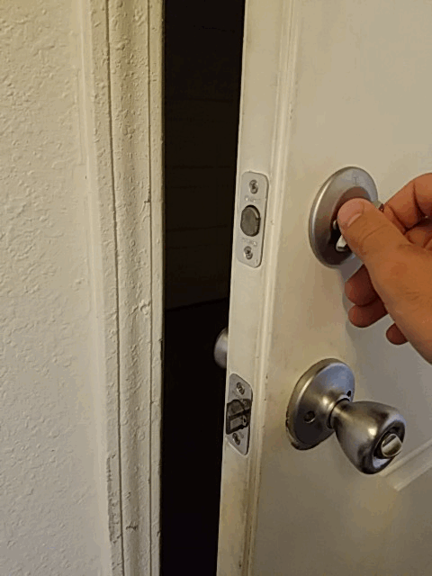
Our Objective:
Access perimeter
Make “Keyless Home Entry”
Automate deadbolt function using Raspberry Pi and Android Application
Notes:
MAX

Slide 3
Bill of Materials
Raspberry Pi - Provided
Servo Motor - $20
Dead Bolt - $15
Section of Door - $5
Wires - Provided
3D Printed Casing - Provided
“Very Cheap” - Software does heavy lifting
Notes:
Christen

Slide 4
Run on Pi Startup
Added python file to /etc/init.d
File header
File permissions
Allows user to have functionality without needing to manually start script. No peripherals necessary.
“Out of box” Functionality
Notes:
ZACH

Slide 5
Bluetooth
Why Bluetooth?
Relative ease of use
Reliability
Server/Client relationship between Pi and Android Device
Devices Identified via MAC address
Notes:
Tyler

Slide 6
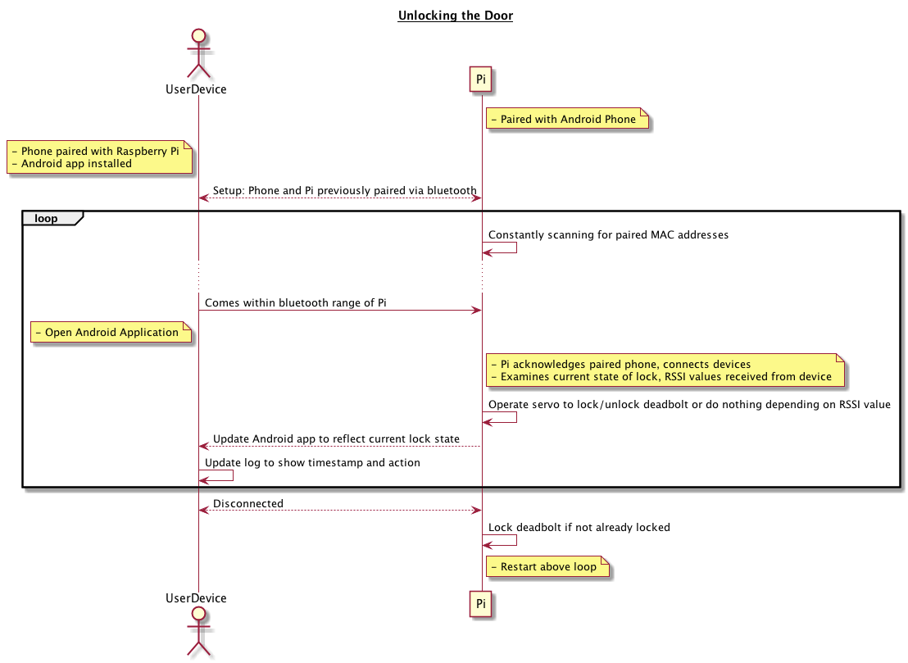
Bluetooth Protocol
Notes:
ZACH

Slide 7
Determining Phone Proximity
Connection method between Pi and Android Device
Bluetooth
Server/Client Relationship (Pi/Android)
Need consistent proximity behavior using bluetooth
Received Signal Strength Indication (RSSI)
Notes:
Issue: Bluetooth CONNECTED or DISCONNECTED
How do we get “Proximity Behavior” ?
MAX

Slide 8
RSSI Values - Determine Locking
Strong Signal
0
Unlock
Poll/Record 20 RSSI sample values on in Python script (Raspberry Pi)
Convert values to integers, average the integers
Examine current state, lock/unlock if necessary
-6
Lock
Weak Signal
Notes:
MAX

Slide 9
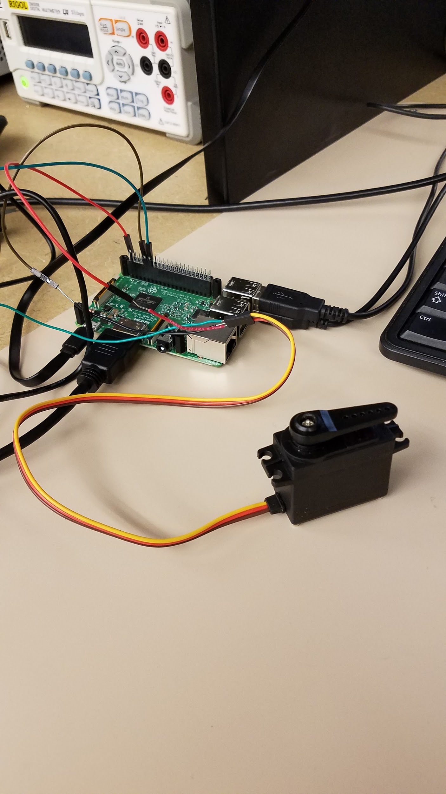
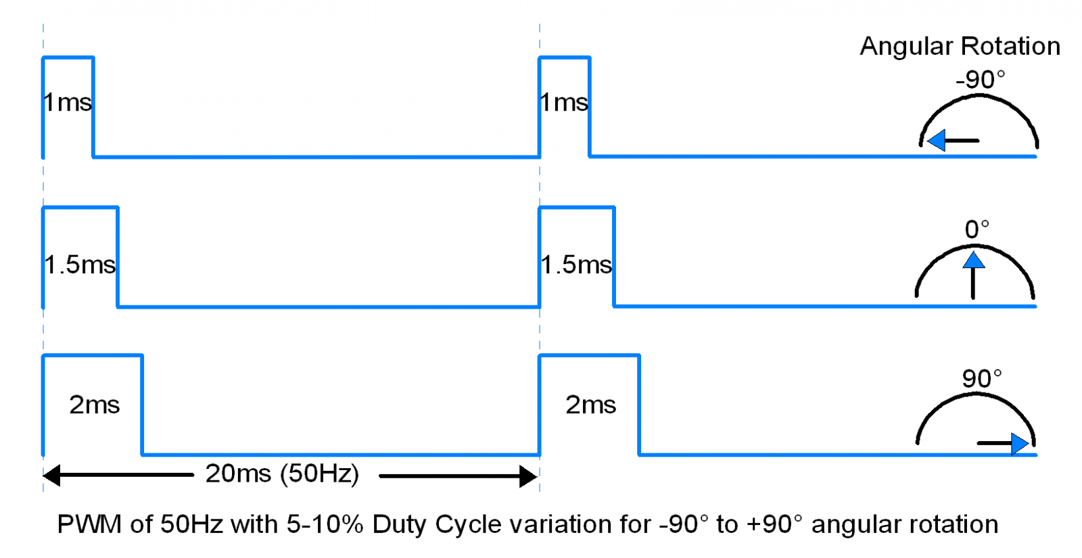
Servo Motor - Turns Deadbolt
Notes:
TYLER

Slide 10
ACCOMPLISHED VIA: Bluetooth Connection
Primary Goals:
1) The Android phone must communicate with the Raspberry Pi controlled via an application on the phone and sensors on the Raspberry Pi. - COMPLETED
Notes:
CHRISTEN

Slide 11
2) The Raspberry Pi turns the deadbolt to unlocked if phone is within a given range. It should also automatically lock once the phone is out of the range. The range will be determined via sensors attached to the Raspberry Pi. - COMPLETED
ACCOMPLISHED VIA: RSSI Values
Primary Goals:
Notes:
MAX

Slide 12
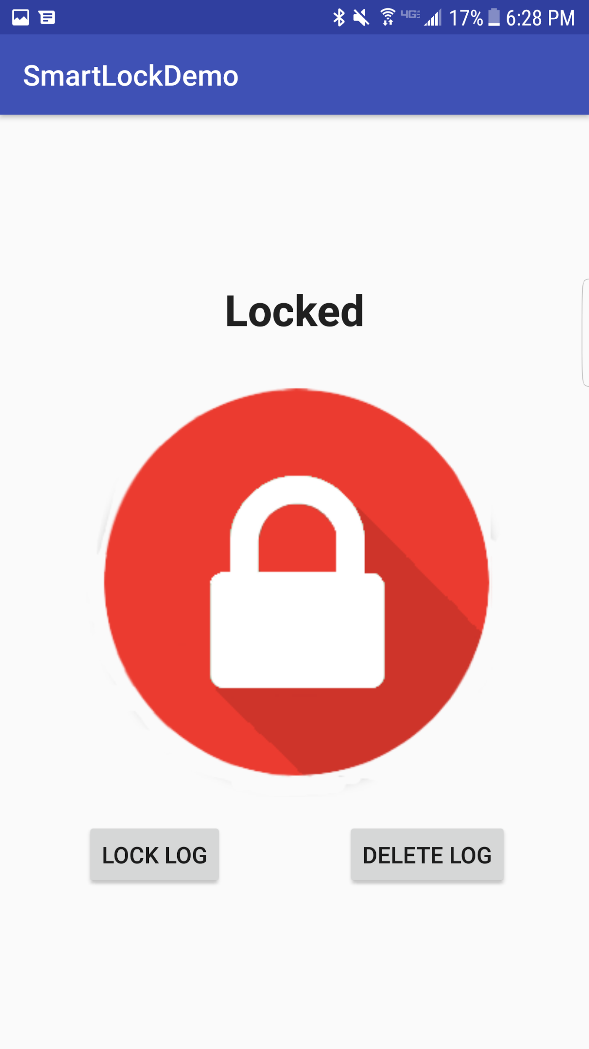
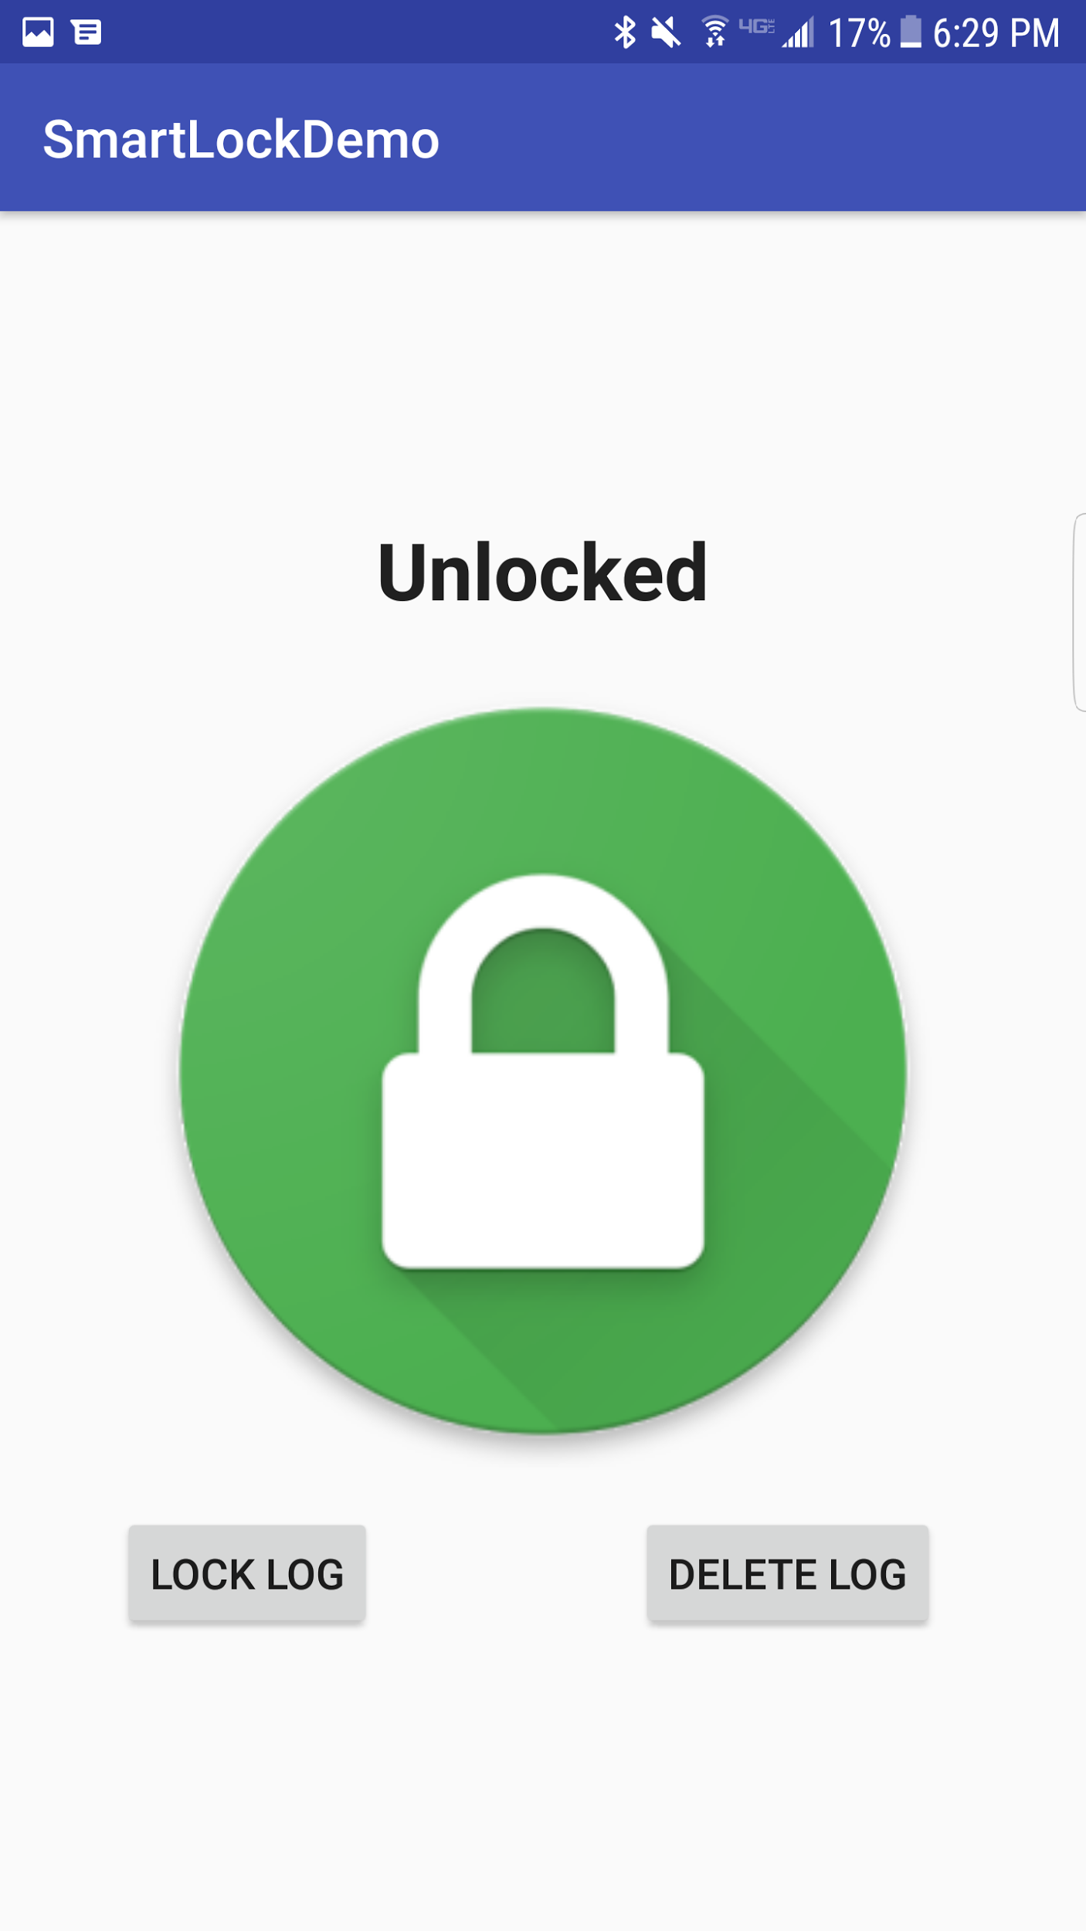
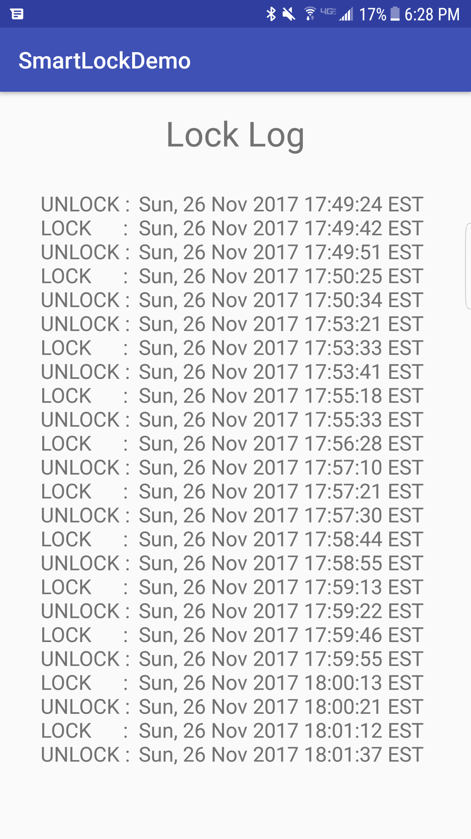
3) On the application, the user should be able to know the status of the door to tell them if it is locked or unlocked. - COMPLETED
Primary Goals:
Notes:
ZACH

Slide 13
Secondary Goal: Lock Log Database
Database on Android phone with SQLite - COMPLETED
Each time the state of the lock changes the time and status are captured
Each time it is stored as an entry to a table
Clicking the Lock Log button prints the entire table on a fresh activity
Delete Log button removes all entries from the table
Notes:
TYLER

Slide 14
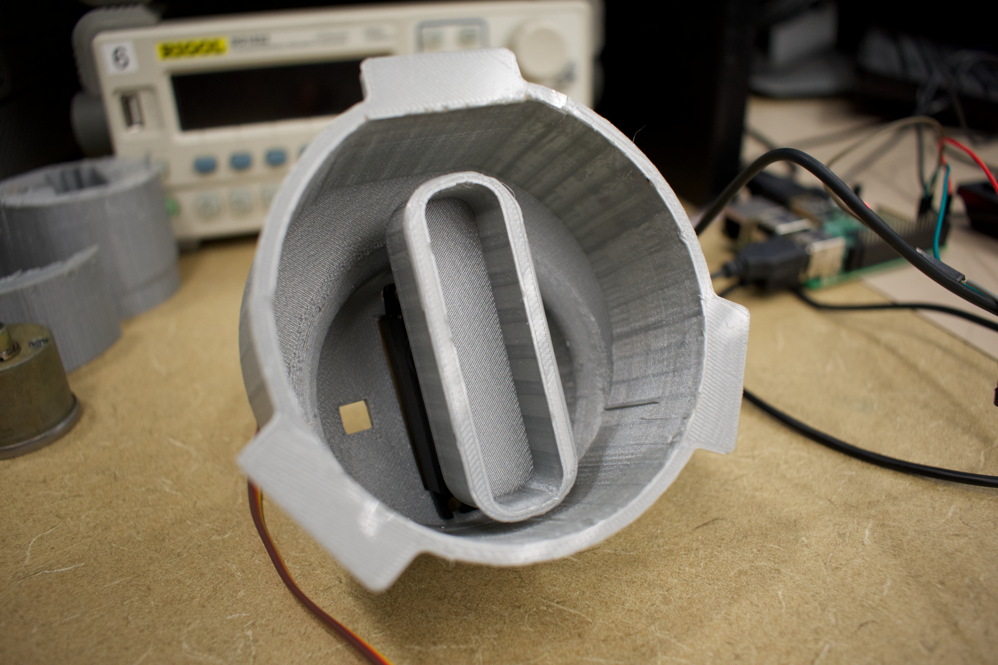
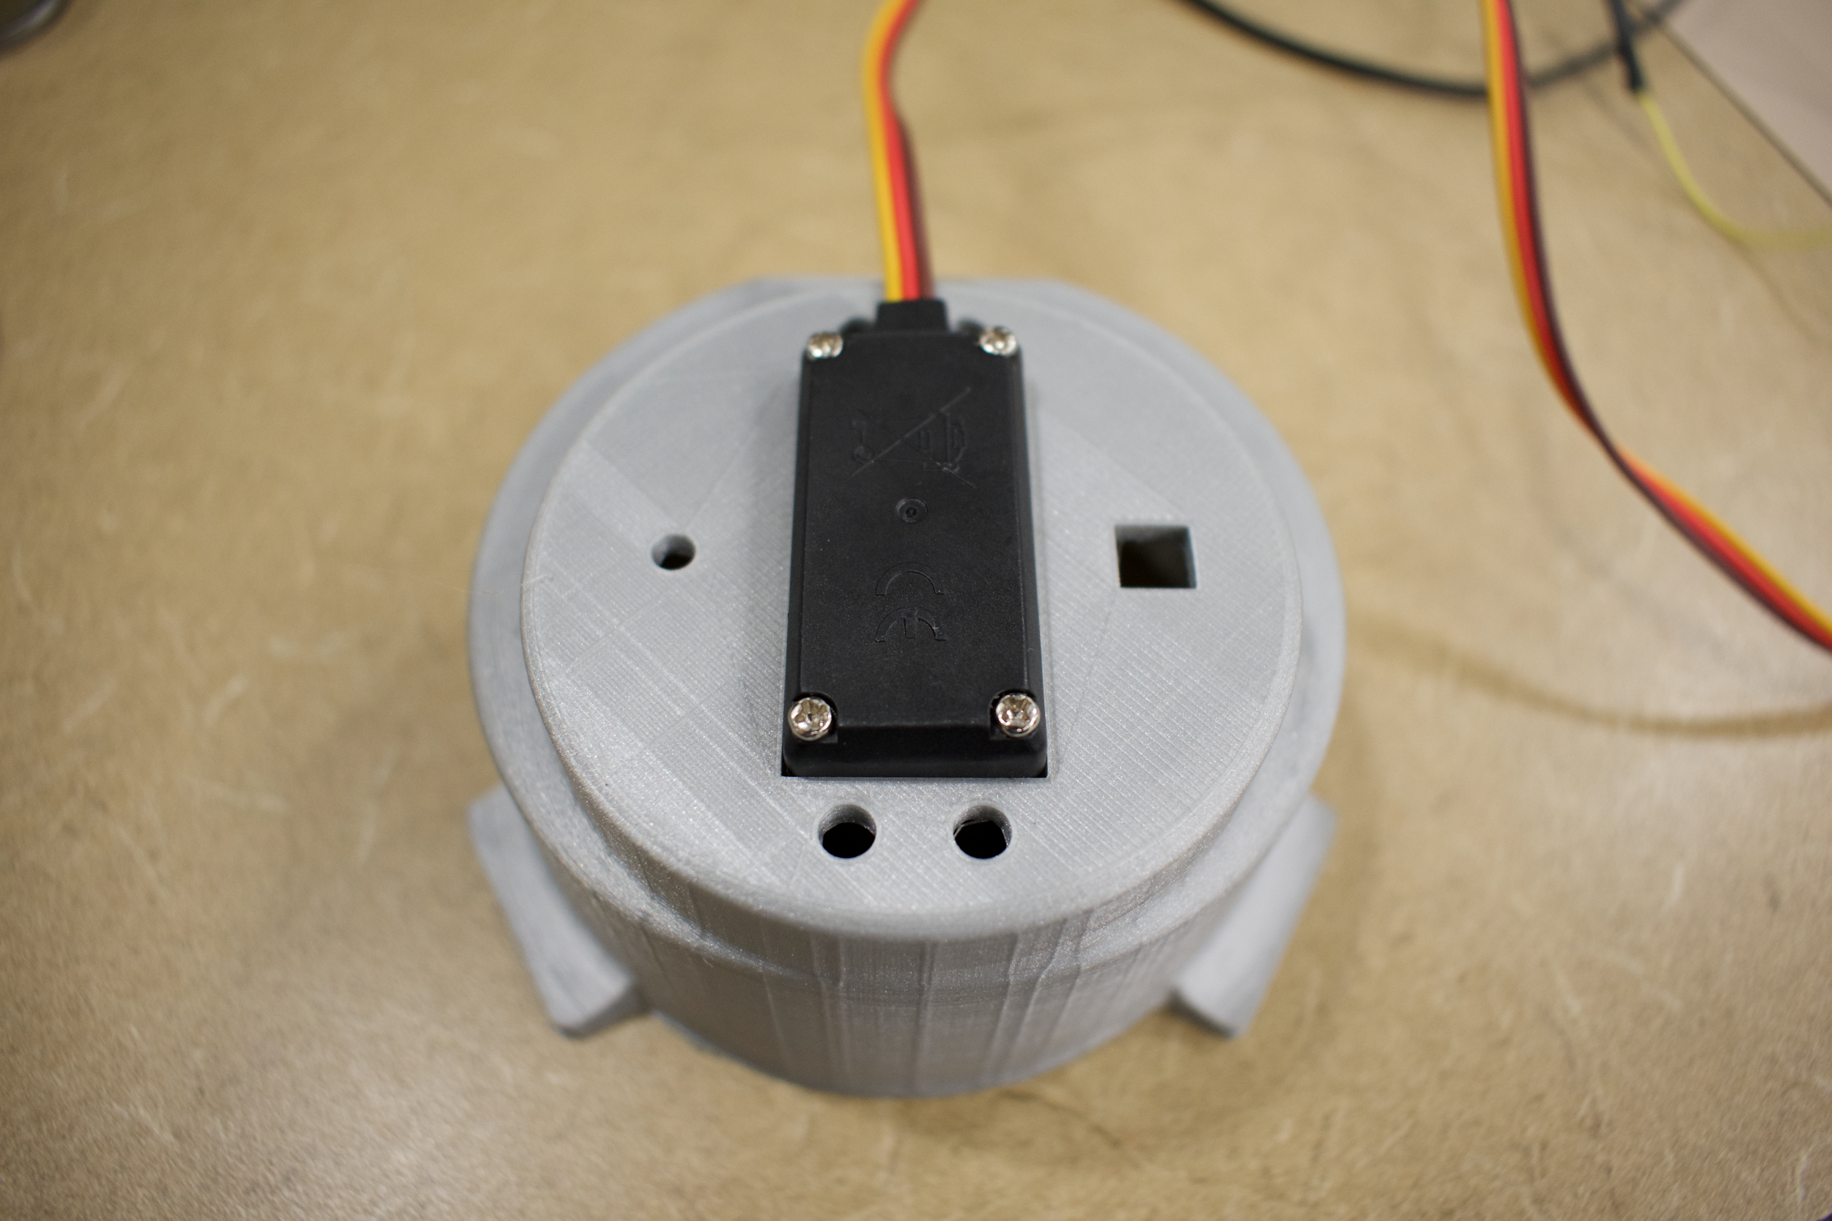
Secondary Goal: 3D Printed Case
COMPLETED
Notes:
CHRISTEN

Slide 15

Notes:
CHRISTEN

Slide 16
Guest Access via Remote Lock/Unlock
Camera Attachment to View People Outside
Higher Security with Pin Pad
Alert to Shaking/Attempts to Enter without Key
Door Open/Closed Sensor
Future Add-ons and Direction:
Notes:
TYLER

Slide 17
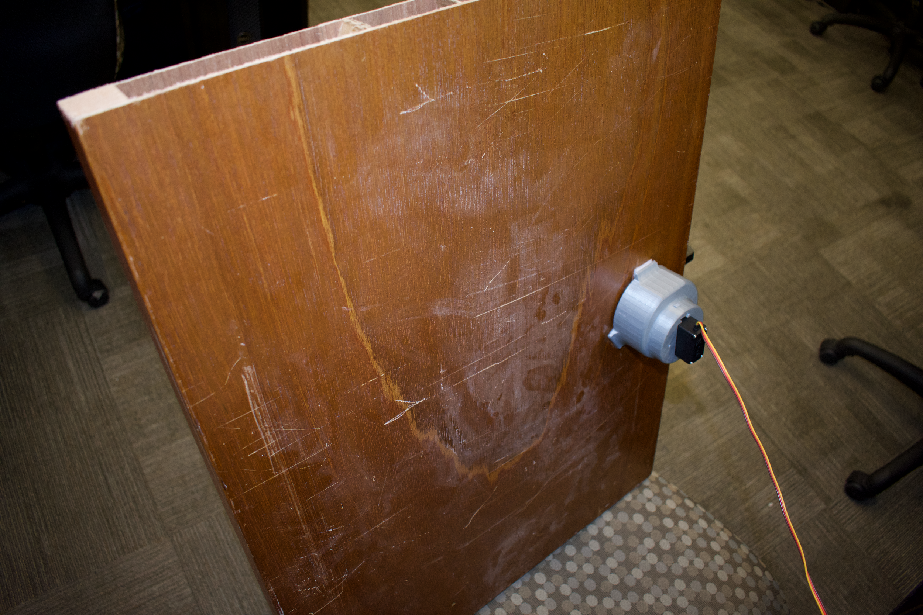
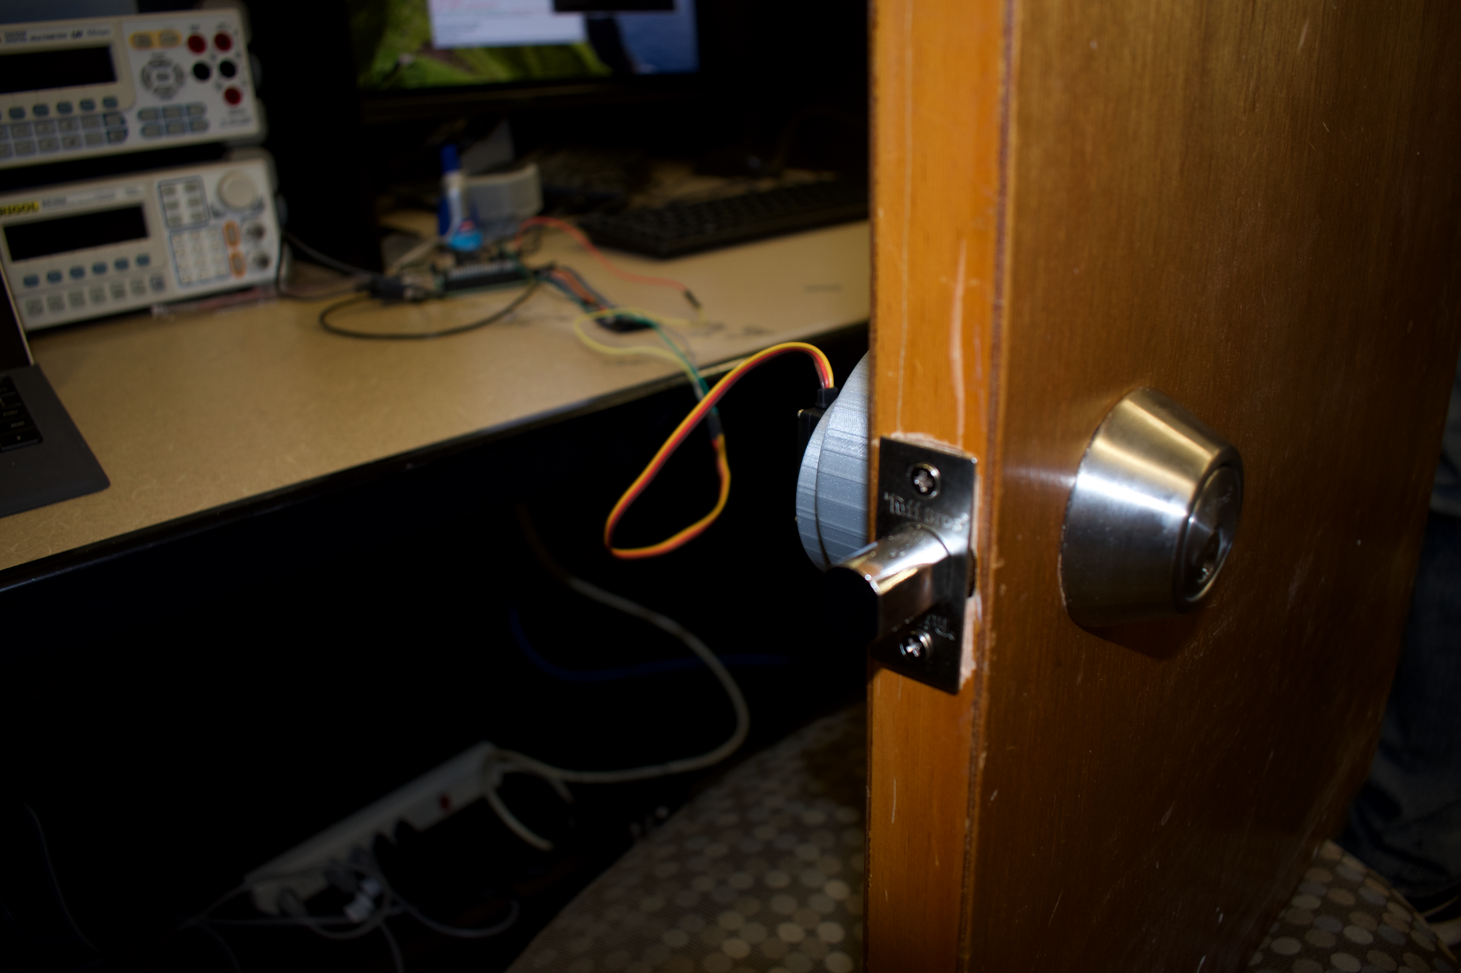

Slide 18
Video Demonstration

Slide 19
Questions?

